Slide 1
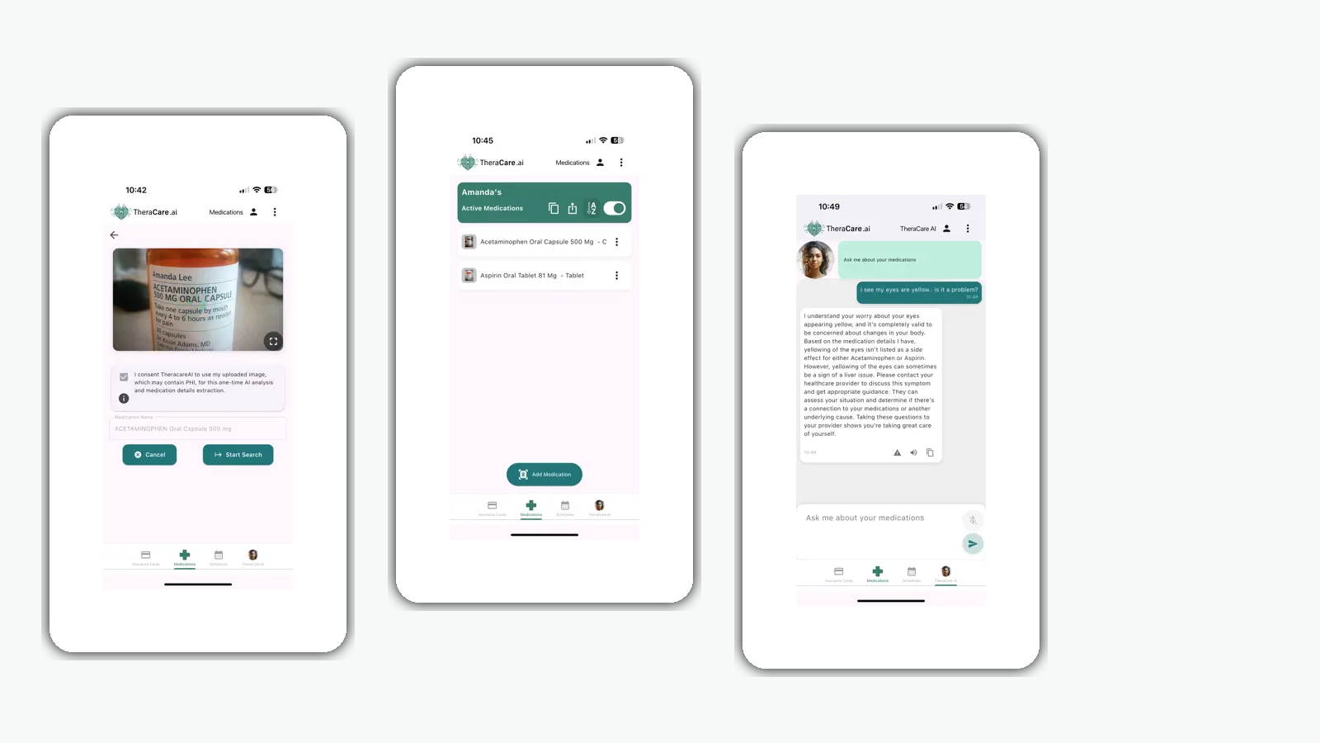
01
The Machiavellians
TheraCare
Post-Discharge Add-on
Updated Need and Approach for Assignment 13
A narrower version of our original project that fits inside an app patients can already use.
Simple post-discharge support, medication follow-up, and red-flag symptom checks.

Slide 2
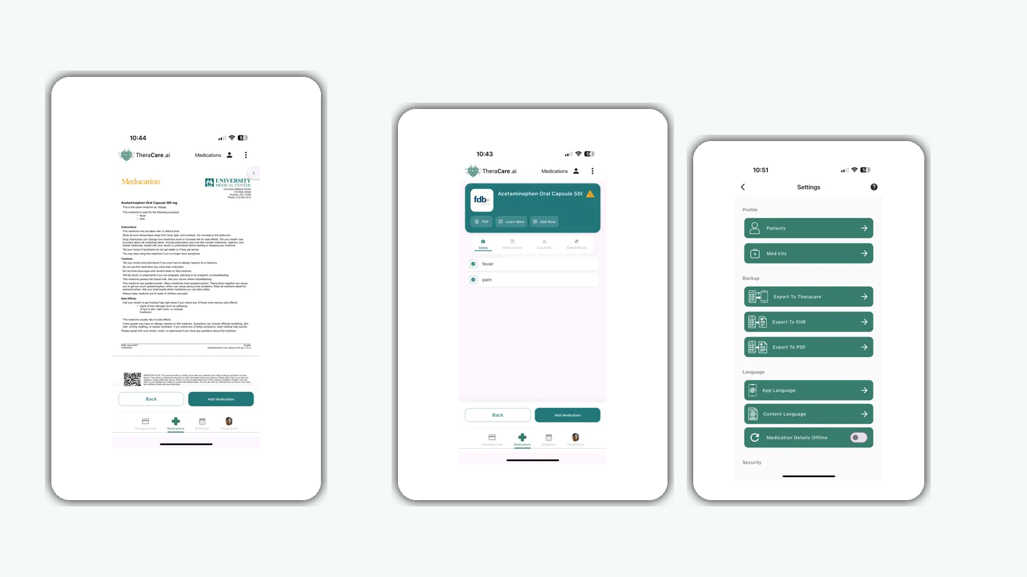
02
The need became narrower and more practical
What stayed the same
Patients leave the hospital with complex instructions.
They may miss medications, symptoms, or follow-up tasks.
They still need support after discharge.
What changed
We are not building a whole new platform anymore.
We are adding discharge support inside TheraCare.
That makes the project more realistic for a course MVP.

Slide 3
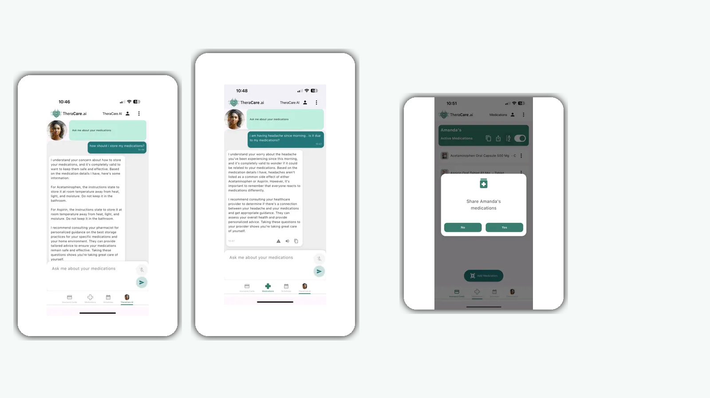
03
Our current approach inside TheraCare
The add-on turns discharge information into a short follow-up workflow.
1
Read discharge details
Use diagnosis, medications, follow-up tasks, and warning symptoms.
2
Create a simple care plan
Rewrite instructions into short patient-friendly actions.
3
Ask check-in questions
Confirm meds, symptoms, and appointment follow-through.
4
Flag risky answers
Show a basic risk level and tell the patient when to seek help.

Slide 4
04
Why this version makes more sense
Useful for patients
What we learned
Makes after-hospital care easier to follow.
AI adds value when it supports understanding, follow-up, and early warnings. It is less useful when we try to make it run an entire healthcare workflow by itself.
Reduces dependence on memory and paperwork.
Helps patients notice warning signs earlier.
Practical use of AI
Bottom line
Simplify discharge instructions into plain language.
This add-on is a focused, realistic way to improve post-discharge care inside a tool that already supports medication management.
Generate short check-in questions from the care plan.
Classify responses into simple risk levels.
Not diagnosis. Not autonomous decision-making. It supports patients and surfaces concerns.

